Slide 1
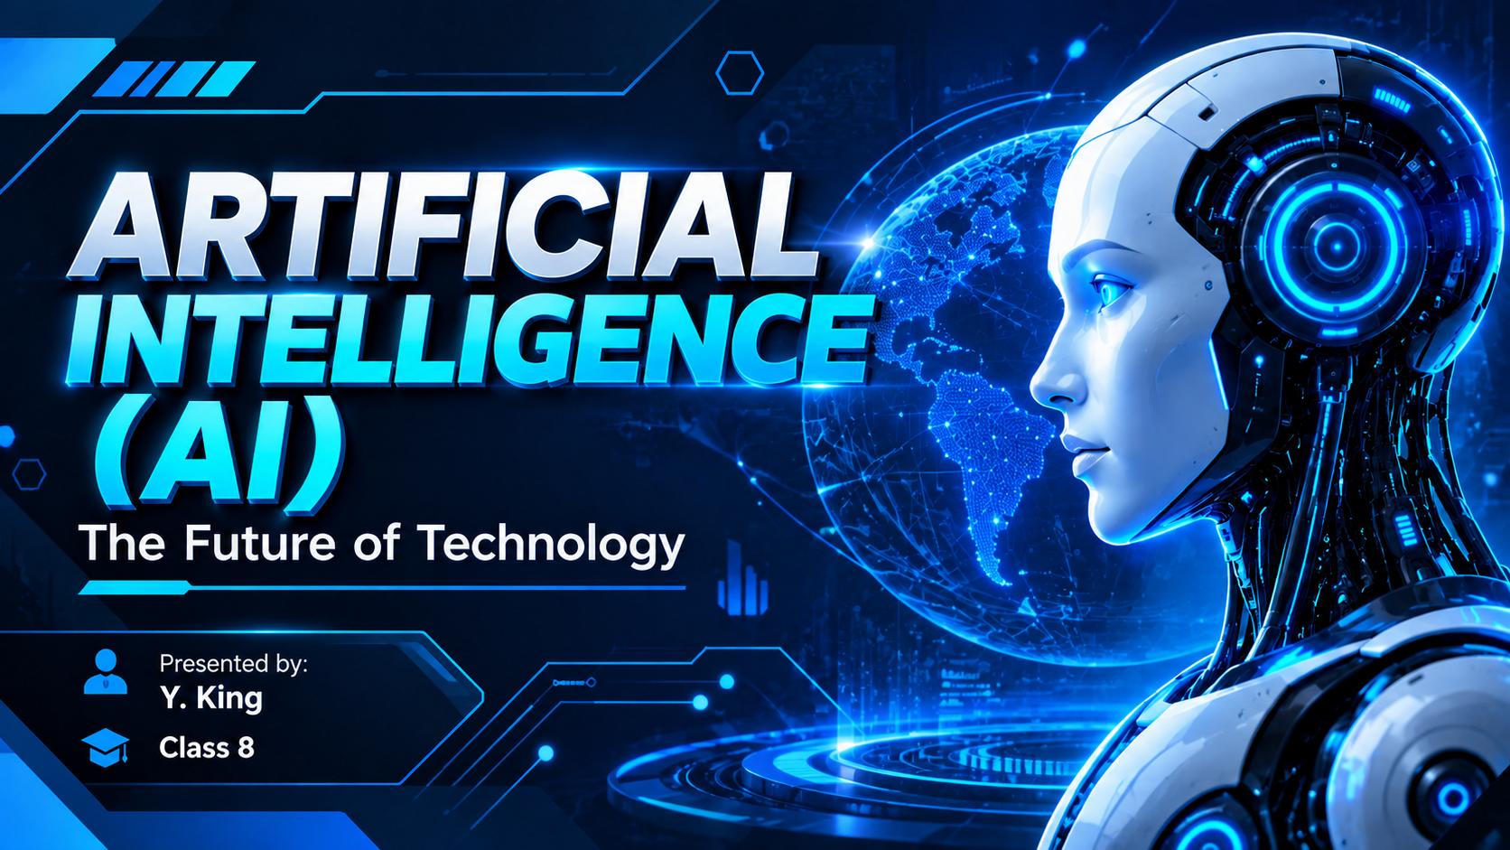
ARTIFICIAL INTELLIGENCE (AI)

Slide 2
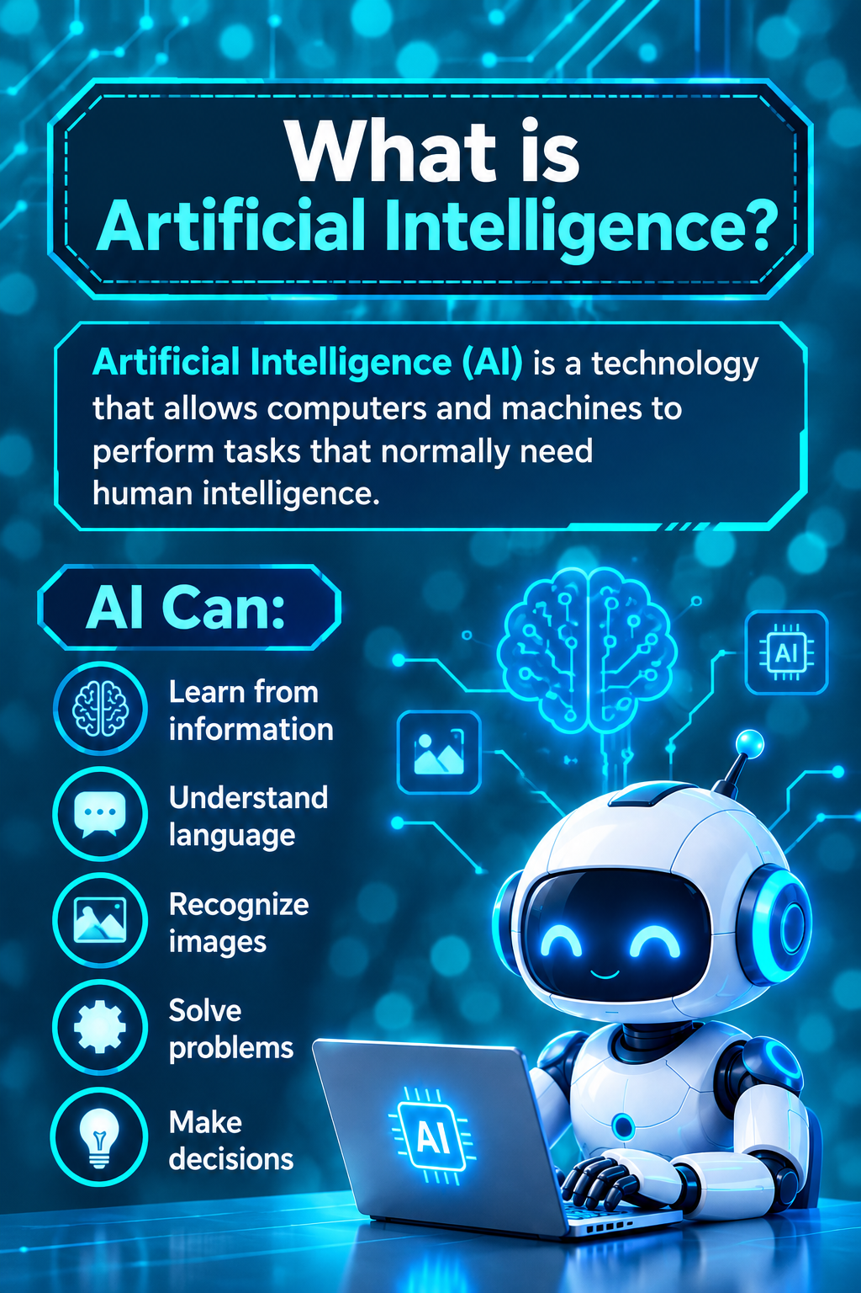
WHAT IS ARTIFICIAL INTELLIGENCE ?
Artificial Intelligence (AI) is a technology that allows computers and machines to perform tasks that normally need human intelligence.
AI CAN:
• Learn from information • Solve problems
• Understand language • Make decisions
• Recognize images • Create new thing

Slide 3
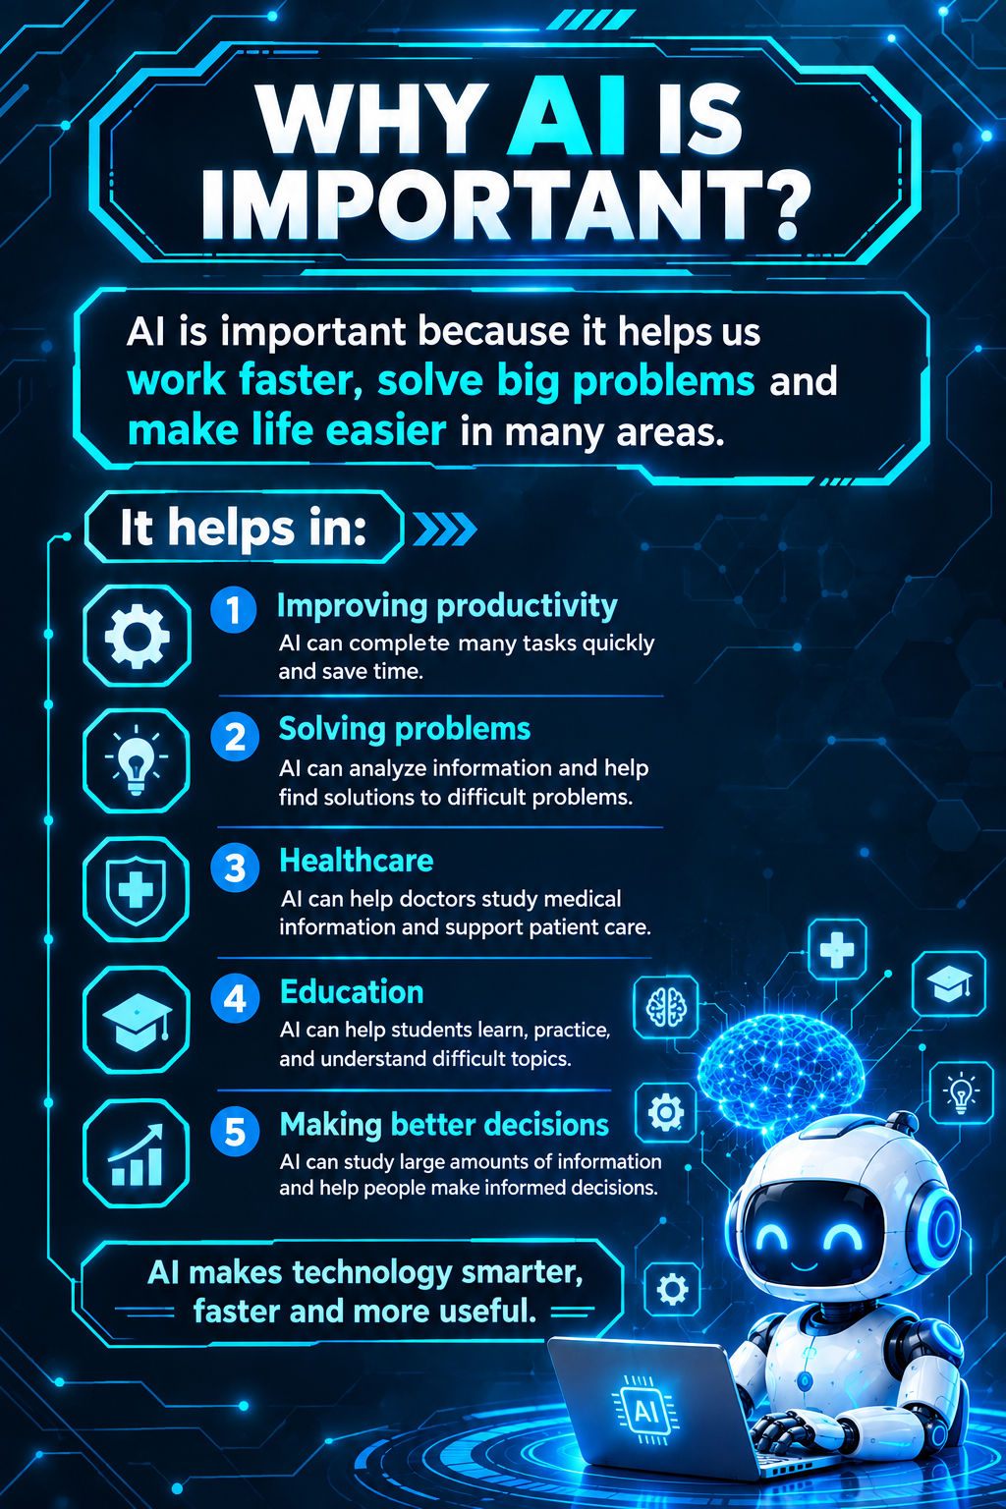
Why AI Is Important ?
Artificial Intelligence is important because it helps people and computers work faster, solve problems, and make better decisions. It is useful in many areas of our daily life.
AI Helps In:
1. Improving Productivity
AI can complete many tasks quickly and save time.
2. Solving Problems
AI can analyze information and help find solutions to difficult problems.
3. Healthcare
AI can help doctors study medical information and support patient care.
4. Education
AI can help students learn, practice, and understand difficult topics.
5. Making Better Decisions
AI can study large amounts of information and help people make informed decisions.
“AI makes technology smarter, faster, and more useful.”

Slide 4
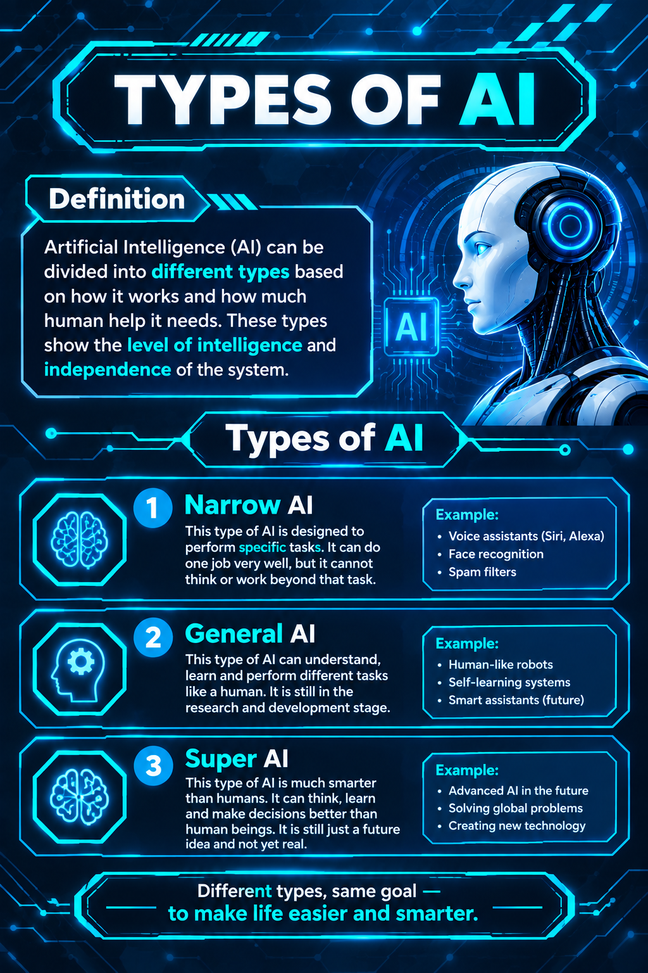
Types of AI ?
Artificial Intelligence can be divided into different types based on how it works and how much human-like intelligence it can have.
1. Narrow AI
Narrow AI is designed to perform specific tasks.
Examples: Voice assistants, face recognition, spam filters.
2. General AI
General AI is a future type of AI that could learn and perform many different tasks like a human. It is still being researched.
3. Super AI
Super AI is a theoretical future idea in which AI could become more capable than humans in many areas. It does not currently exist.
Different types, same goal — to make life easier and smarter

Slide 5
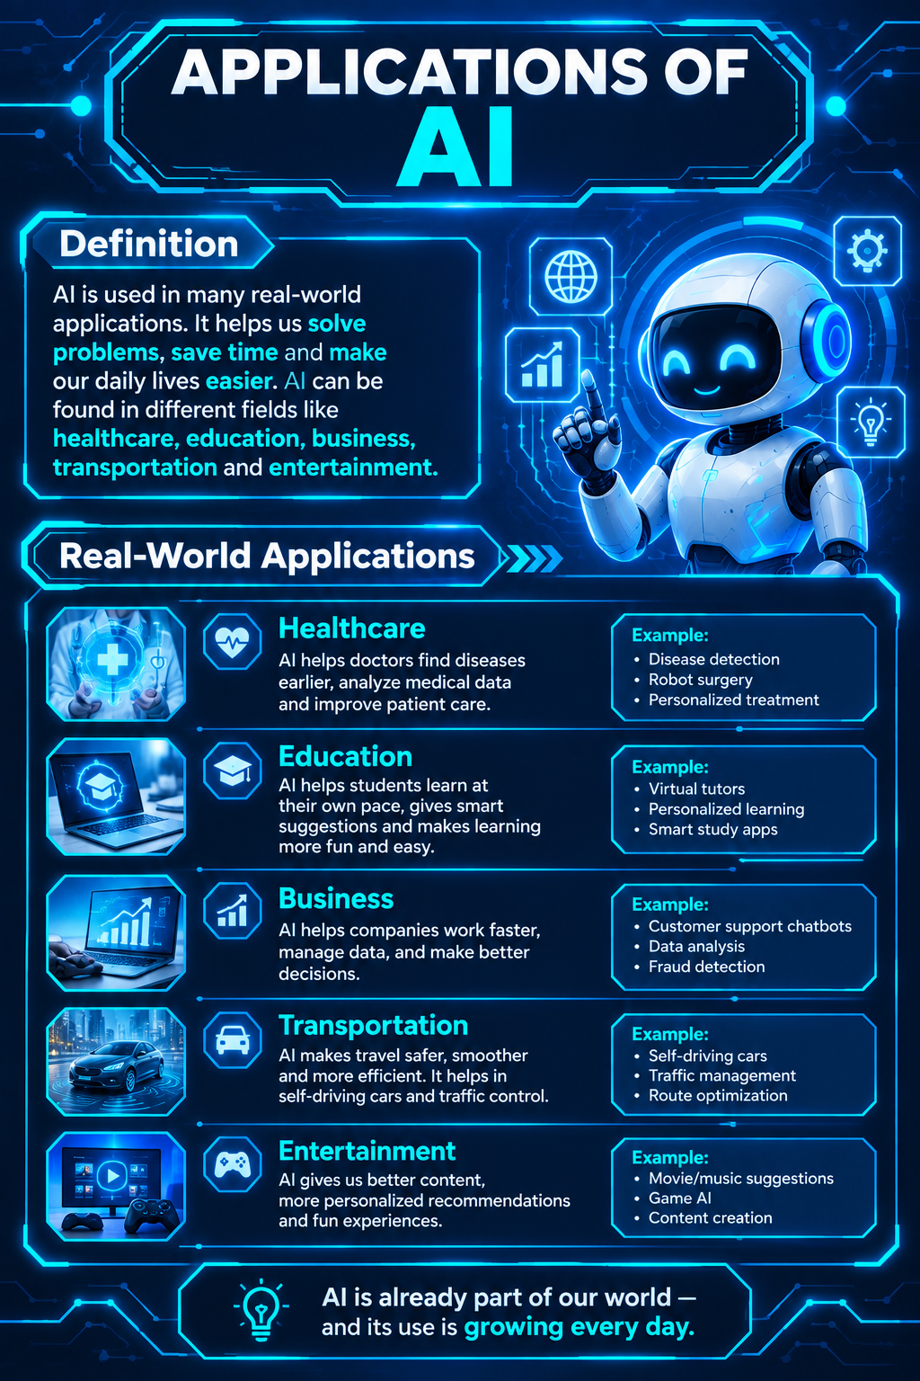
Applications of AI ?
AI is used in many real-world applications. It helps us solve problems, save time, and make our daily lives easier.
AI is used in:
Healthcare — Helps doctors and patients.
Education — Helps students learn.
Business — Helps companies work faster.
Transportation — Helps improve travel and traffic.
Entertainment — Gives better recommendations and experiences.

Slide 6
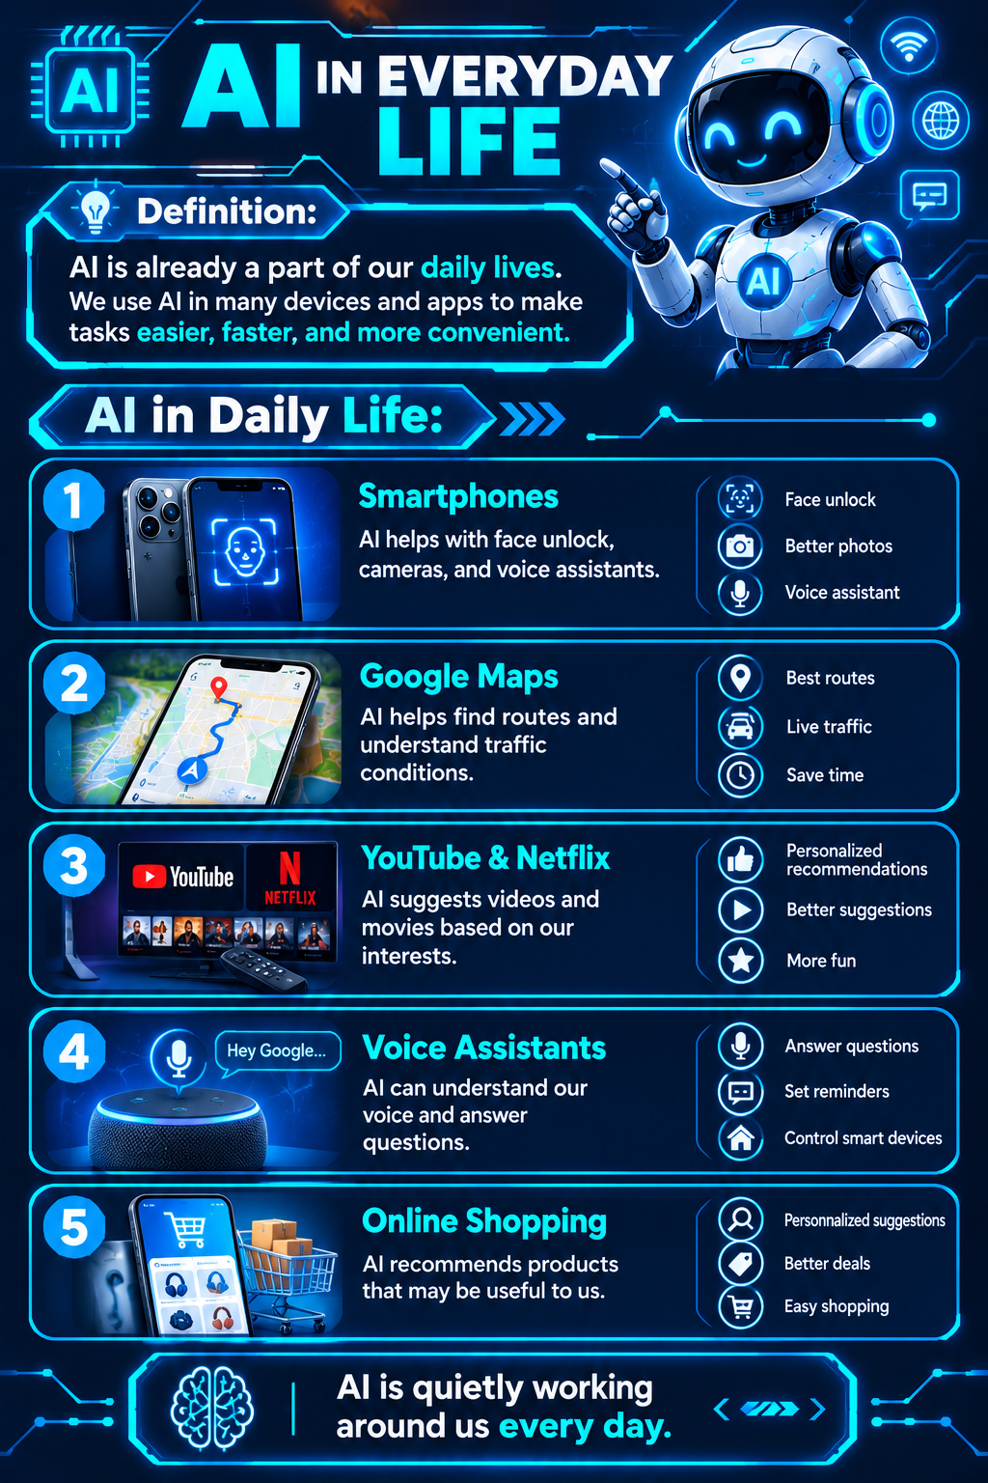
AI in Everyday Life
AI is already a part of our daily lives. We use AI in many devices and apps to make tasks easier, faster, and more convenient.
AI in Daily Life:
1. Smartphones 📱
AI helps with face unlock, cameras, and voice assistants.
2. Google Maps 🗺️
AI helps find routes and understand traffic conditions.
3. YouTube & Netflix 🎬
AI suggests videos and movies based on our interests.
4. Voice Assistants 🎙️
AI can understand our voice and answer questions.
5. Online Shopping 🛒
AI recommends products that may be useful to us.
AI is quietly working around us every day.

Slide 7
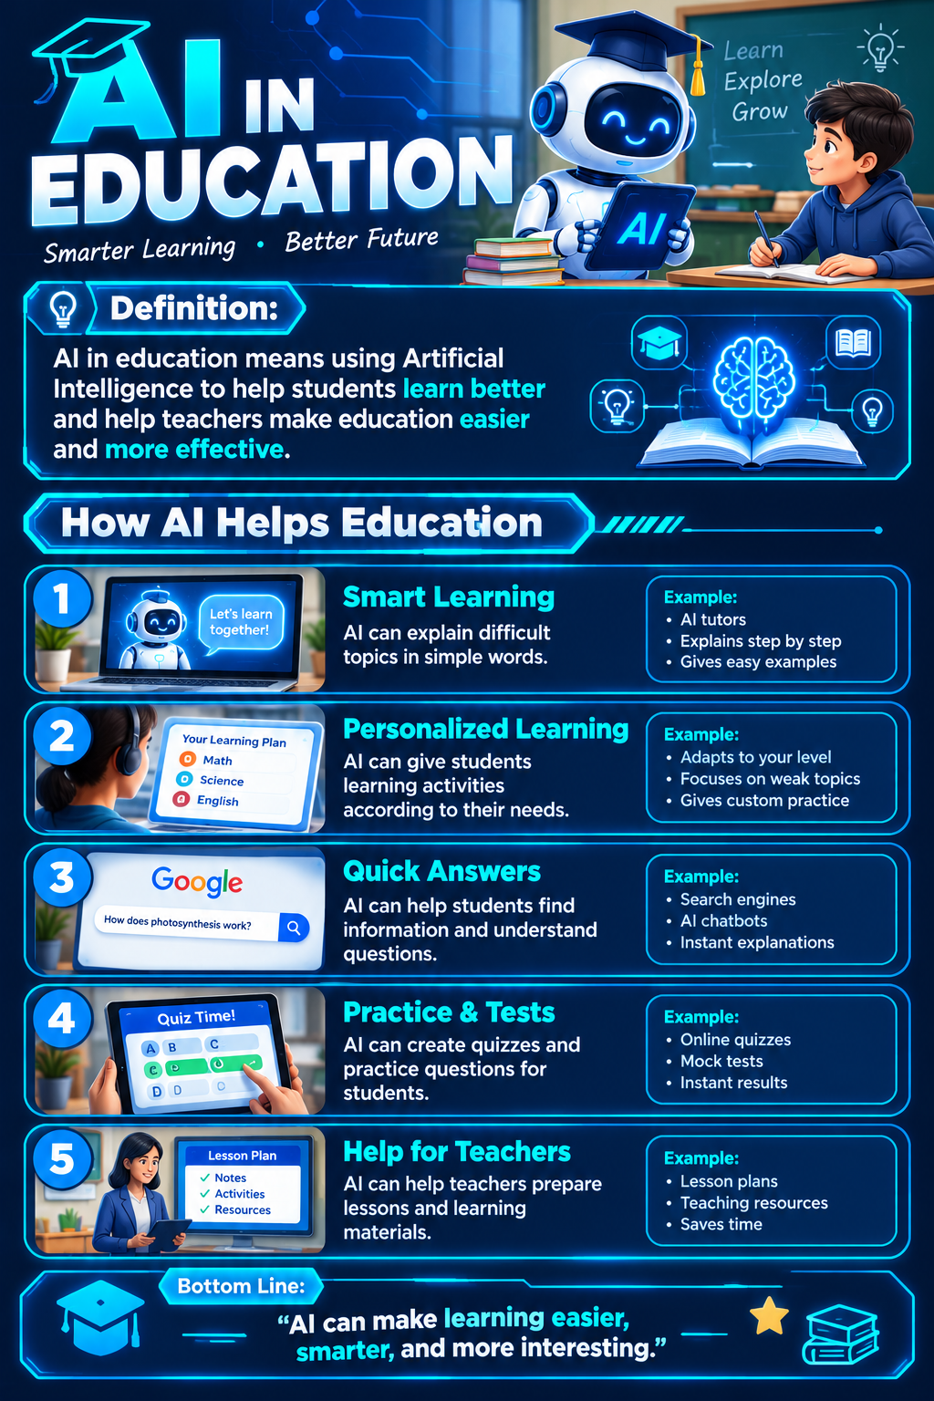
AI in Education
AI in education means using Artificial Intelligence to help students learn better and help teachers make education easier and more effective.
How AI Helps Education
1. Smart Learning
AI can explain difficult topics in simple words.
2. Personalized Learning
AI can give students learning activities according to their needs.
3. Quick Answers
AI can help students find information and understand questions.
4. Practice & Tests
AI can create quizzes and practice questions for students.
5. Help for Teachers
AI can help teachers prepare lessons and learning materials.
“AI can make learning easier, smarter, and more interesting.”

Slide 8
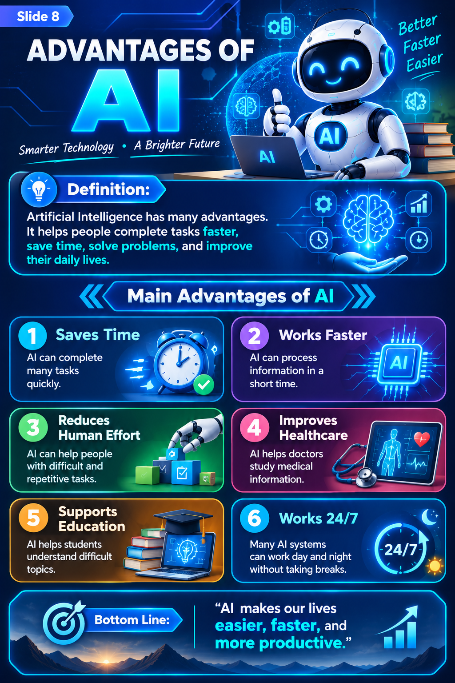
Advantages of AI
Artificial Intelligence has many advantages. It helps people complete tasks faster, save time, solve problems, and improve their daily lives.
Main Advantages of AI
1. Saves Time
AI can complete many tasks quickly.
2. Works Faster
AI can process information in a short time.
3. Reduces Human Effort
AI can help people with difficult and repetitive tasks.
4. Improves Healthcare
AI helps doctors study medical information.
5. Supports Education
AI helps students understand difficult topics.
6. Works 24/7
Many AI systems can work day and night without taking breaks.
AI makes our lives easier, faster, and more productive.”

Slide 9
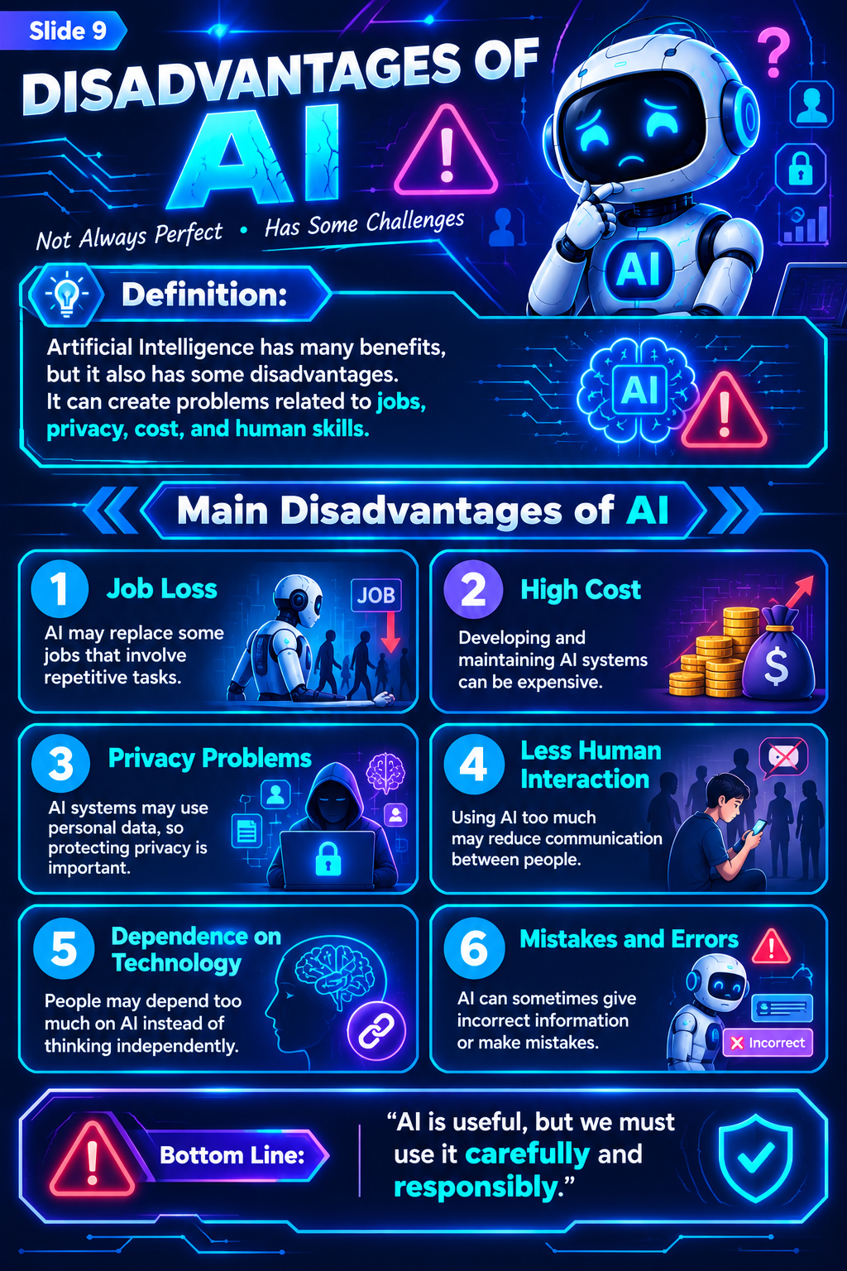
Disadvantages of AI
Artificial Intelligence has many benefits, but it also has some disadvantages. It can create problems related to jobs, privacy, cost, and human skills.
Main Disadvantages of AI
1. Job Loss AI may replace some jobs that involve repetitive tasks.
2. High Cost Developing and maintaining AI systems can be expensive.
3. Privacy Problems AI systems may use personal data, so protecting privacy is important.
4. Less Human Interaction Using AI too much may reduce communication between people.
5. Dependence on Technology People may depend too much on AI instead of thinking independently.
6. Mistakes and Errors AI can sometimes give incorrect information or make mistakes.
“AI is useful, but we must use it carefully and responsibly.”

Slide 10
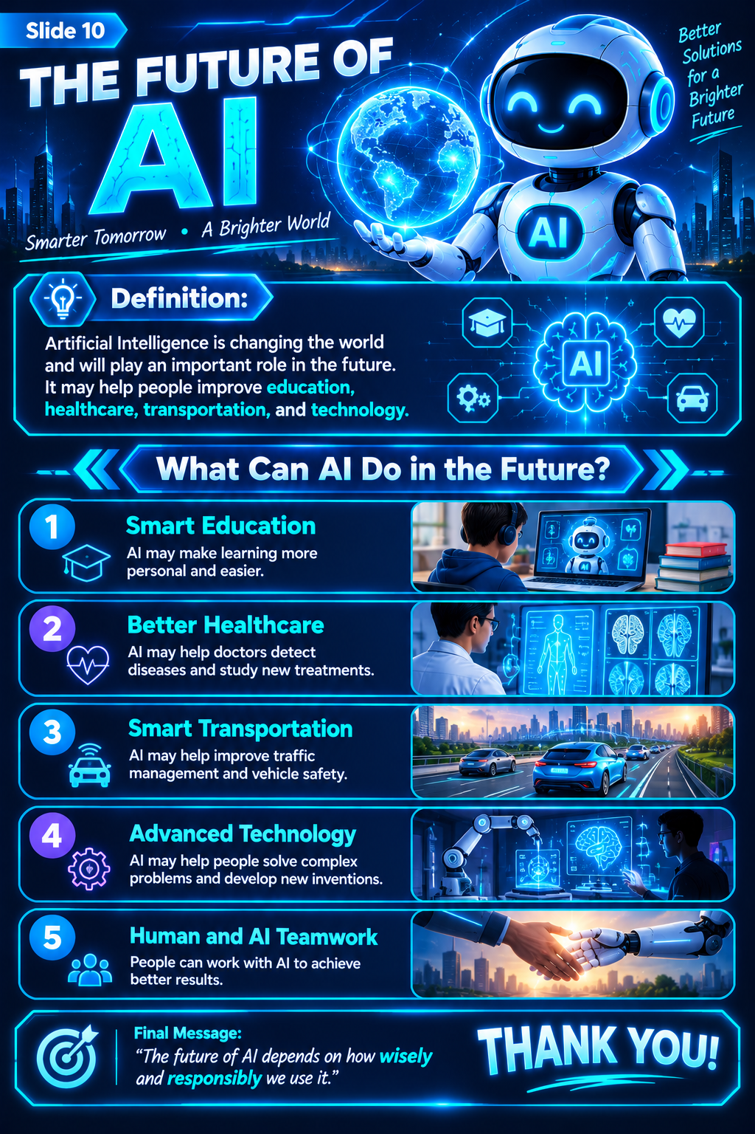
The Future of AI
Artificial Intelligence is changing the world and will play an important role in the future. It may help people improve education, healthcare, transportation, and technology.
What Can AI Do in the Future?
1. Smart Education : AI may make learning more personal and easier.
2. Better Healthcare : AI may help doctors detect diseases and study new treatments.
3. Smart Transportation : AI may help improve traffic management and vehicle safety.
4. Advanced Technology : AI may help people solve complex problems and develop new inventions.
5. Human and AI Teamwork : People can work with AI to achieve better results.
“The future of AI depends on how wisely and responsibly we use it.”

Slide 11
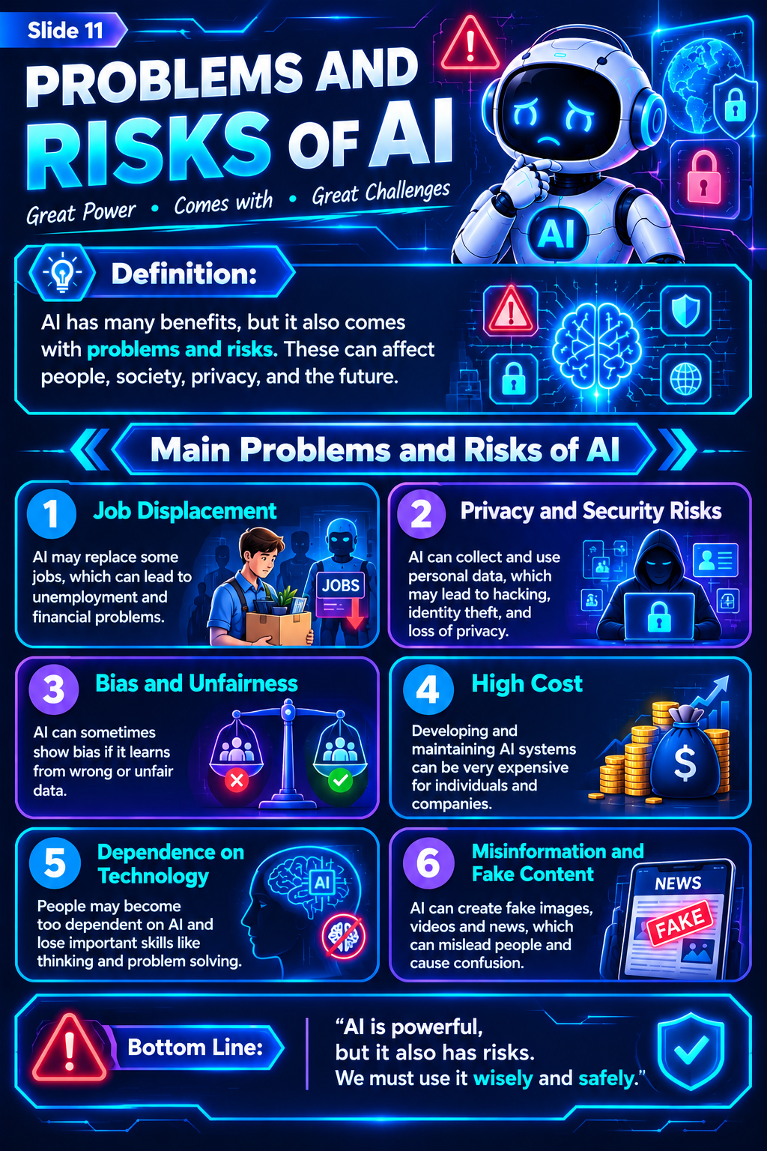
Problems and Risks of AI
Artificial Intelligence has many benefits, but it also comes with problems and risks. These can affect people, society, privacy, and the future.
Main Problems and Risks of AI
Job Displacement: AI may replace some jobs and cause unemployment.
Privacy and Security Risks: AI may misuse personal data and create privacy problems.
Bias and Unfairness: AI can make unfair decisions if it learns from incorrect or biased data.
High Cost: Developing and maintaining AI systems can be expensive.
Dependence on Technology: People may depend too much on AI and use their own skills less.
Misinformation and Fake Content: AI can create fake images, videos, and information that mislead people.
“AI is powerful, but it also has risks. We must use it wisely and safely.”

